Slide 1







WELCOME
Conclusion
Conclusion
Bibliography
Application
Need of the system
Introduction
Project profile
Existing system
Developed by
Development
DEVELOPED BY
Harshil Sorathiya
Viral Panchal

Slide 2
YOURCARS
Android App with sqlite database
Conclusion
Conclusion
Introduction
Bibliography
Application
Need of the system
Project profile
Existing system
Developed by
Development
Developed at RBIMS
The Car Application is an Android app that allows users to explore multiple car brands, view details, and book test drives in one place. Admins can manage cars, users, and test drive bookings efficiently.

Slide 3
Your Cars
2025
1
FEATURES
Conclusion
Conclusion
Introduction
Bibliography
Application
Need of the system
Existing system
Project profile
Developed by
Development
Car app where admin manages cars and bookings, and users view cars and book test drives.

Slide 4

Objective of the New System
01
Provide a Unified Platform
02
User Management
Conclusion
Conclusion
Introduction
Bibliography
Application
Need of the system
System Design
Existing system
Developed by
Development
Project profile
03
Admin Management
04
Car Information Display
05
Test Drive Booking
06
Enhanced User Experience

Slide 5




Project Title
Yourcars
Version Control
Bit Bucket
Project Duration
3 MONTHS
Conclusion
Conclusion
Introduction
Bibliography
Application
Need of the system
Developed by
Development
Project profile
Existing system
Internal Guide
Prof.Himani Khodifad
(RBIMS)
Tools
Android studio Narwhal,
DBBrowser(sqlite)

Slide 6
01
02
03
04
Development
(Coding standard)
Conclusion
Introduction
Conclusion
Conclusion
Introduction
Bibliography
Bibliography
Application
Application
Need of the system
System Design
Existing system
Developed by
Development
Project profile
Developed by

Slide 7
Development
Coding Standards
Android coding standard :
1)Login Credentials
if (checkcredentials)
{
SharedPreferences.Editor editor = prefs.edit();
editor.putBoolean(LOGIN_KEY,true);
editor.putString(USER_EMAIL_KEY,email);
editor.apply();
Toast.makeText(LoginActivity.this,"Login Sucessfully!", Toast.LENGTH_SHORT).show();
Intent intent = new Intent(getApplicationContext(), DashboardActivity.class);
startActivity(intent);
finish();
}else if (email.equals(ADMIN_USERNAME) && password.equals(ADMIN_PASSWORD)){
Toast.makeText(LoginActivity.this,"Login Sucessfully!", Toast.LENGTH_SHORT).show();
Intent intent = new Intent(getApplicationContext(), FragmentManagmentActivity.classs);
2) Perform Logout
private void performLogout() {
// Clear session data (if you're using SharedPreferences)
getSharedPreferences("isLoggedIn", MODE_PRIVATE)
.edit()
.clear()
.apply();
// Redirect to LoginActivity (replace with your login screen class)
Intent intent = new Intent(this, LoginActivity.class);
intent.setFlags(Intent.FLAG_ACTIVITY_NEW_TASK | Intent.FLAG_ACTIVITY_CLEAR_TASK);
startActivity(intent);
// Finish current activity
finish();
}
private void showLogoutConfirmationDialog() {
new androidx.appcompat.app.AlertDialog.Builder(this)
.setTitle("Logout")
.setMessage("Are you sure you want to log out?")
.setPositiveButton("Yes", (dialog, which) -> performLogout())
.setNegativeButton("Cancel", null)
.show();
}
Conclusion
Introduction
Bibliography
Application
Need of the system
Introduction
System Design
Existing system
Developed by
Development
Project profile
Page 01

Slide 8
Development
5) Submit Booking
private void submitBooking() {
String name = etName.getText().toString().trim();
String email = etEmail.getText().toString().trim();
String contact = etContact.getText().toString().trim();
String date = etDate.getText().toString().trim();
String time = etTime.getText().toString().trim();
String brand = modelSpinner.getSelectedItem() != null ? modelSpinner.getSelectedItem().toString() : "";
if (name.isEmpty() || email.isEmpty() || contact.isEmpty() ||
date.isEmpty() || time.isEmpty() || brand.isEmpty()) {
Toast.makeText(this, "Please fill all fields", Toast.LENGTH_SHORT).show();
return;
}
boolean inserted = dbHelper.insertBooking(name, email, contact, brand, date, time);
if (inserted) {
Toast.makeText(this, "✅ Test Drive Booked Successfully!", Toast.LENGTH_SHORT).show();
startActivity(new Intent(this, DashboardActivity.class));
finish();
} else {
Toast.makeText(this, "❌ Booking Failed", Toast.LENGTH_SHORT).show();
}
Conclusion
Introduction
Bibliography
Application
Need of the system
System Design
Existing system
Developed by
Development
Project profile
Page 02

Slide 9
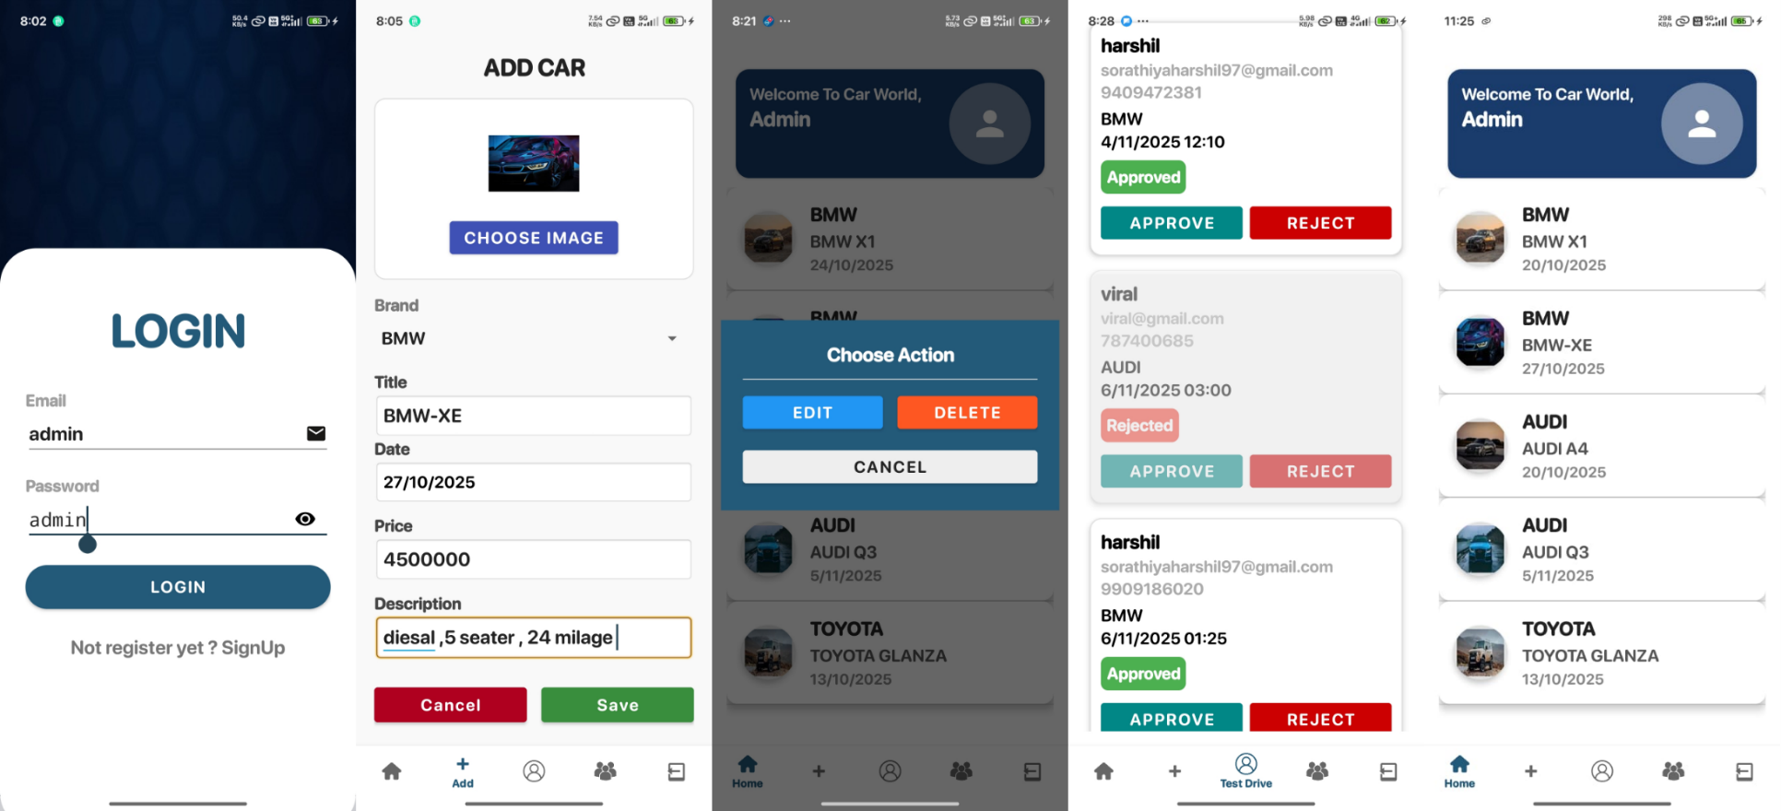
Conclusion
Bibliography
Application
Need of the system
Introduction
Developed by
Project profile
Existing system
Development

Slide 10
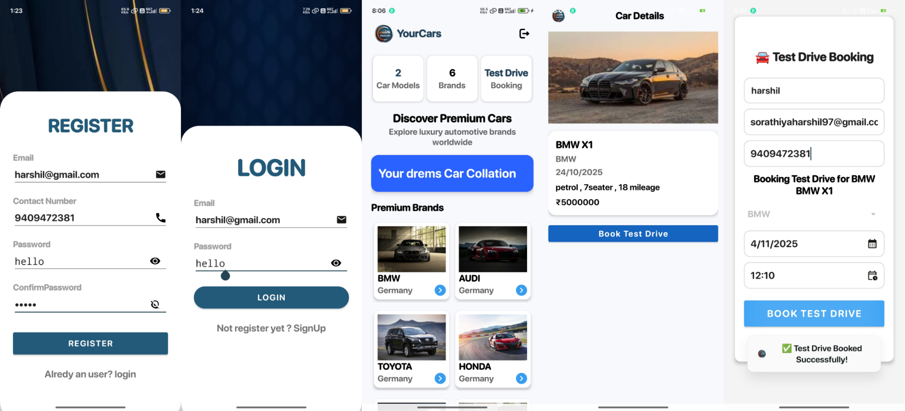
Conclusion
Bibliography
Application
Need of the system
Introduction
Developed by
Project profile
Existing system
Development

Slide 11
Harshil Sorathiya
BVOC-5(IT), RBIMS
(235491105026)
Conclusion
Introduction
Bibliography
Application
Need of the system
Viral Panchal
BVOC-5(IT), RBIMS
(235491105015)
Project profile
Existing system
Developed by
Development

Slide 12




http://stackoverflow.com
https://sqlitebrowser.org/
Conclusion
Need of the system
Introduction
Bibliography
Application
Project profile
Existing system
Developed by
Development
http://www.google.com
http://github.com/
https://www.youtube.com/

Slide 13
YOUR APP’S CONCLUSION
Project Summary: The Car App lets admins manage cars and test drives, while users can view car details and book test drives easily.
2. Achievements: Added login, car management, test drive booking, and Firebase integration.
3. Learning Outcome: Learned Android development, Firebase, UI design, and debugging.
4. Limitations: No online payment or car comparison yet.
5. Future Scope: Add payments, AI suggestions, and Google Maps integration.
Bibliography
Introduction
Conclusion
Application
Need of the system
Developed by
Development
Project profile
Existing system

Slide 14

Thank you

